Slide 1
Payment Gateway with Node.js
S. Turki
Prince Sultan University
04-2023

Slide 2
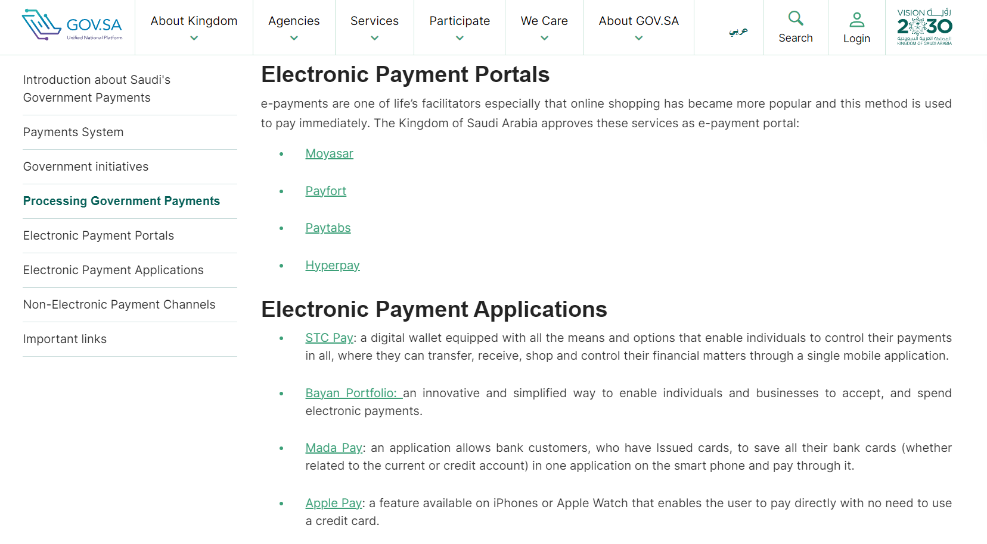
Payment channels in KSA
https://www.my.gov.sa/wps/portal/snp/aboutksa/ePayment/?lang=en

Slide 3
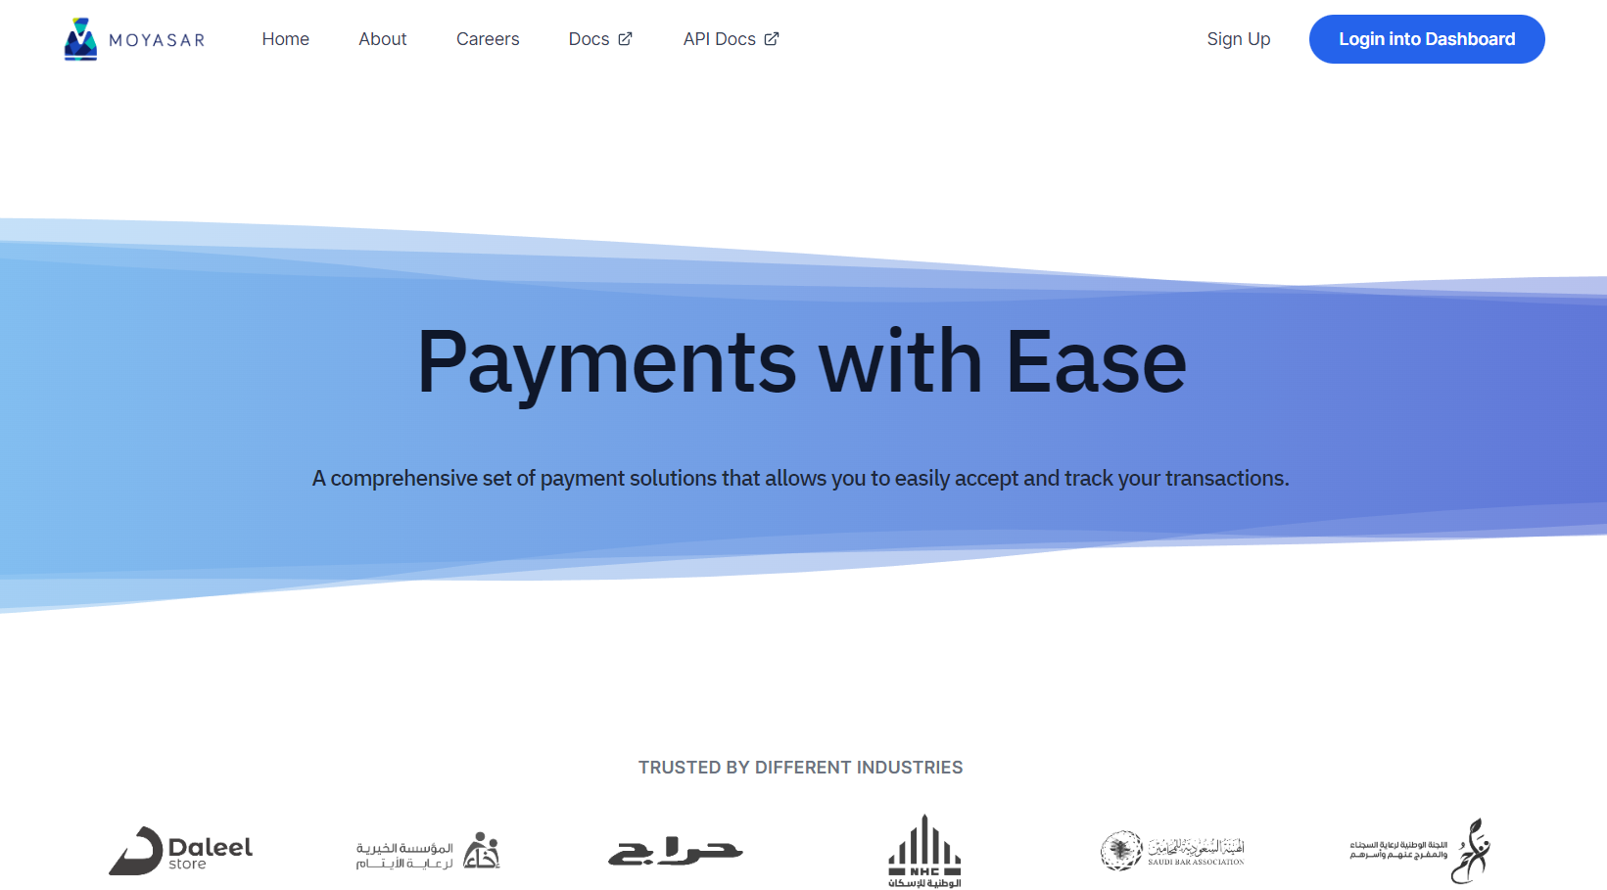
MOYASAR

Slide 4
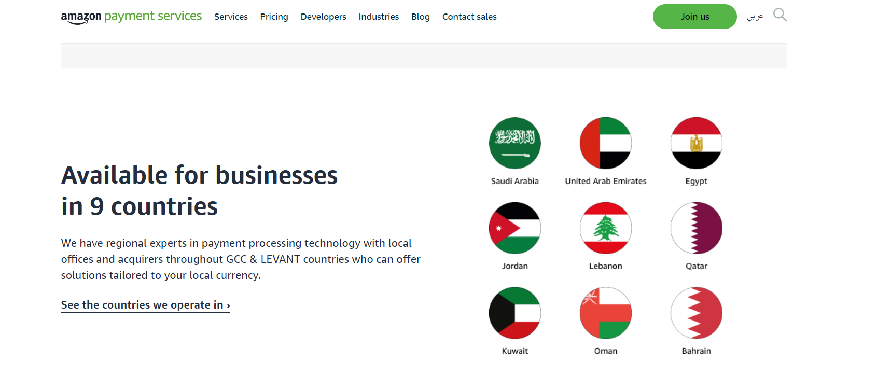
Payfort (Amazon Payment Services)

Slide 5
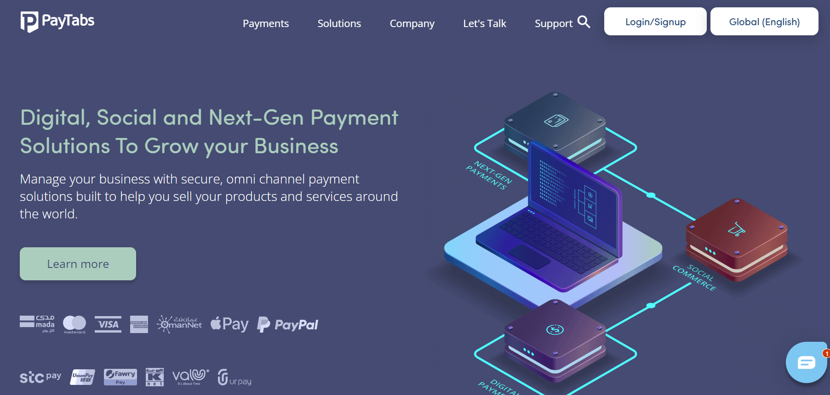
Paytabs

Slide 6
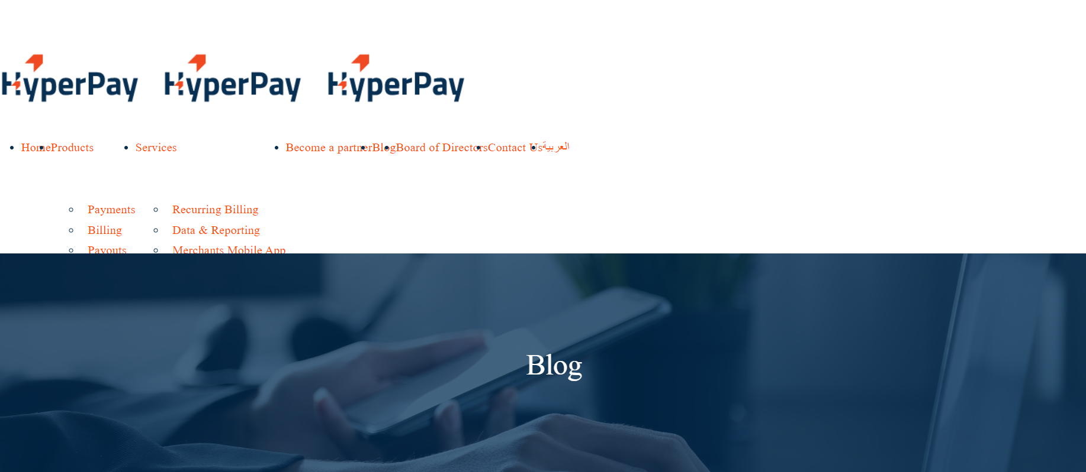
Hyperpay ??!

Slide 7
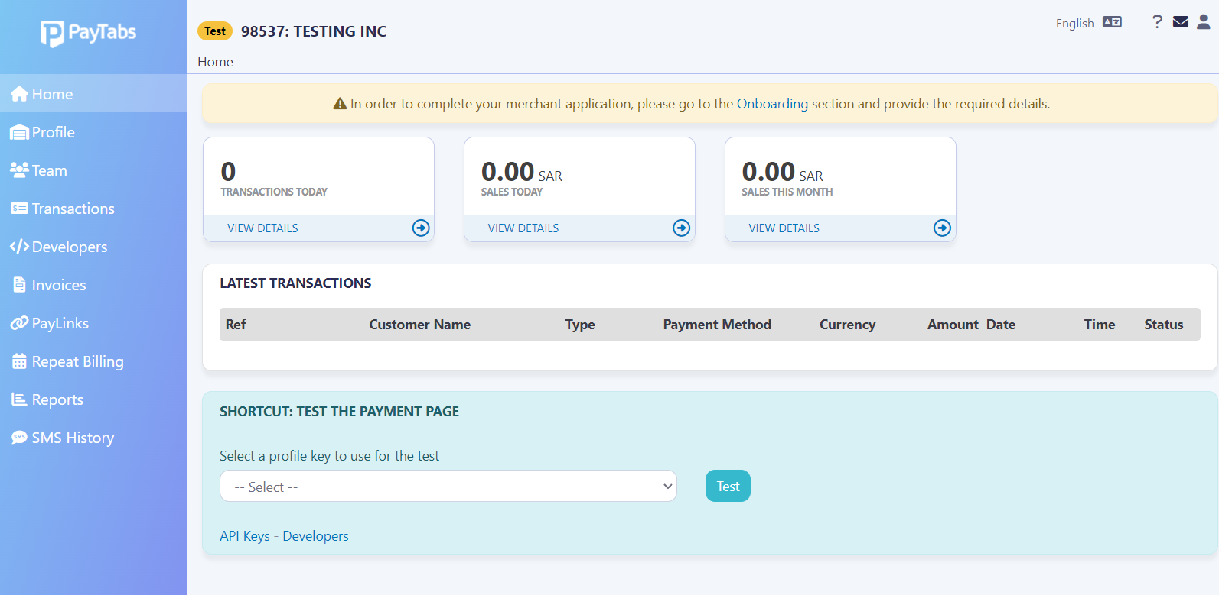
Paytabs dashboard

Slide 8
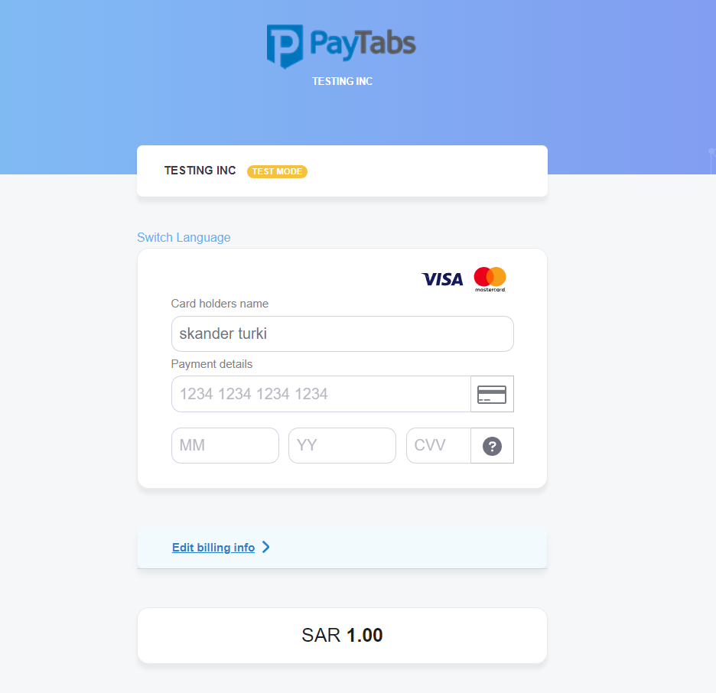
Paytabs: Payment page
https://secure.paytabs.sa/payment/page/5ED615B482E42DDBA76153DD65F5411C4D4E033990A6A39549A0D267/start

Slide 9
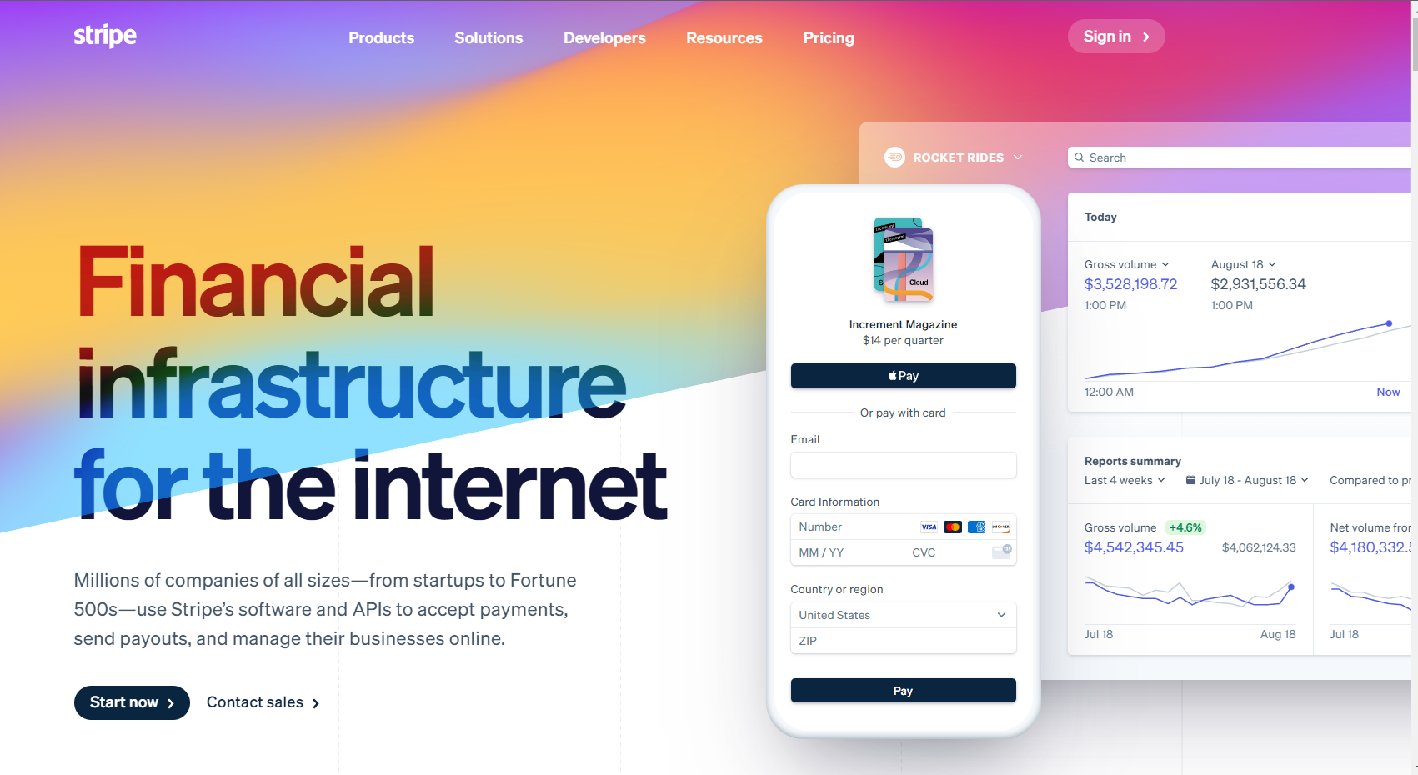
Stripe (not yet available in KSA)
We need to register to a payment gateway service provider:
Stripe is the most popular among node.js developers.

Slide 10
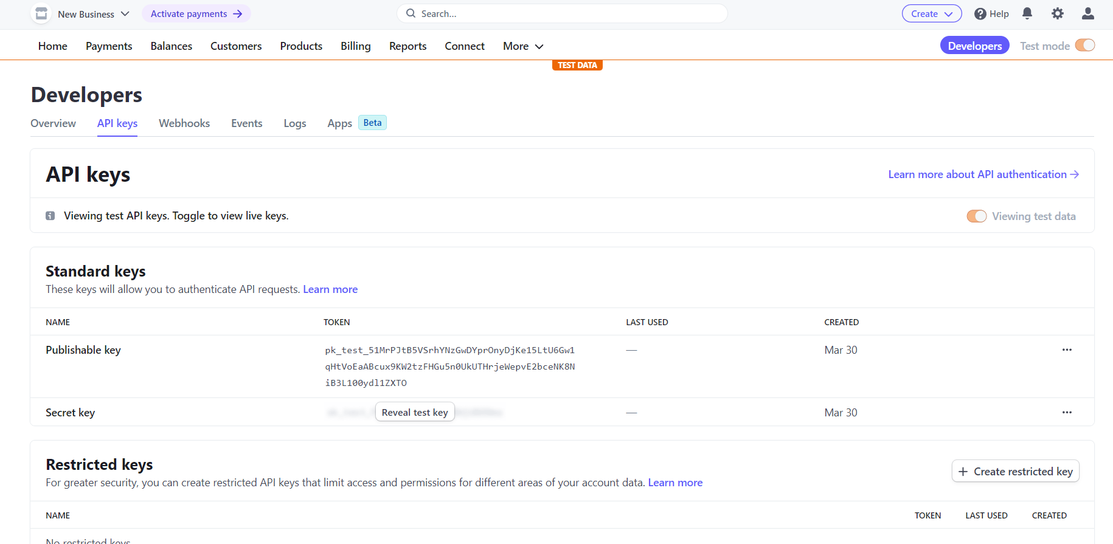
Stripe API Keys

Slide 11
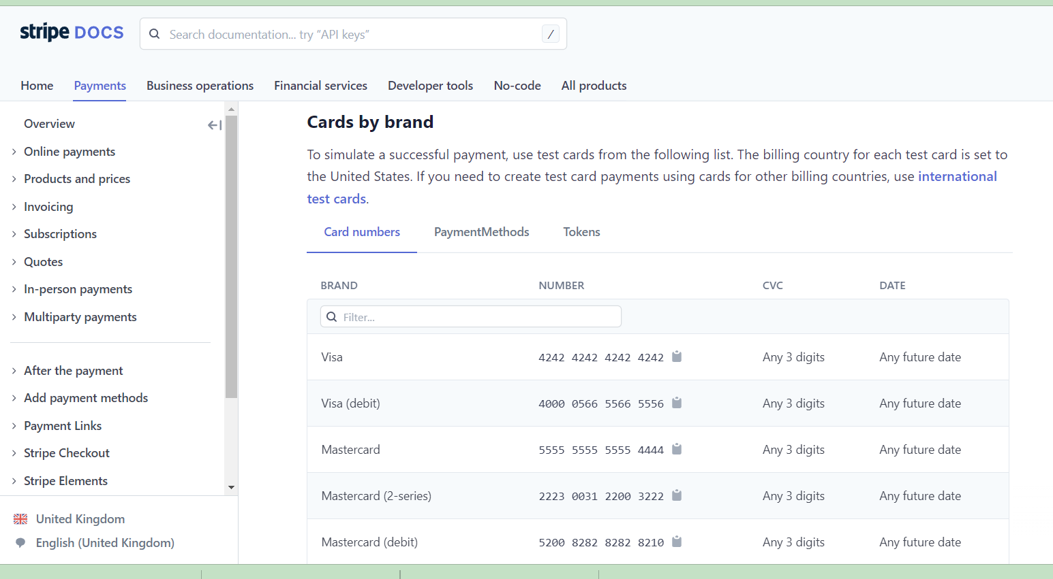
Credit Card numbers for Testing

Slide 12
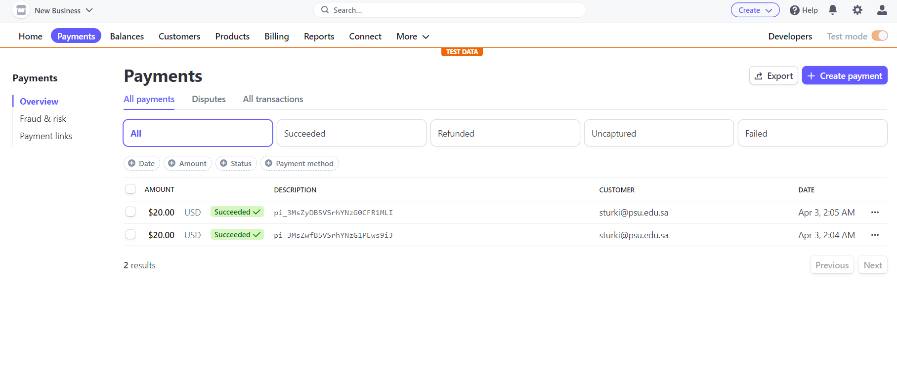
Payments Dashboard

Slide 13
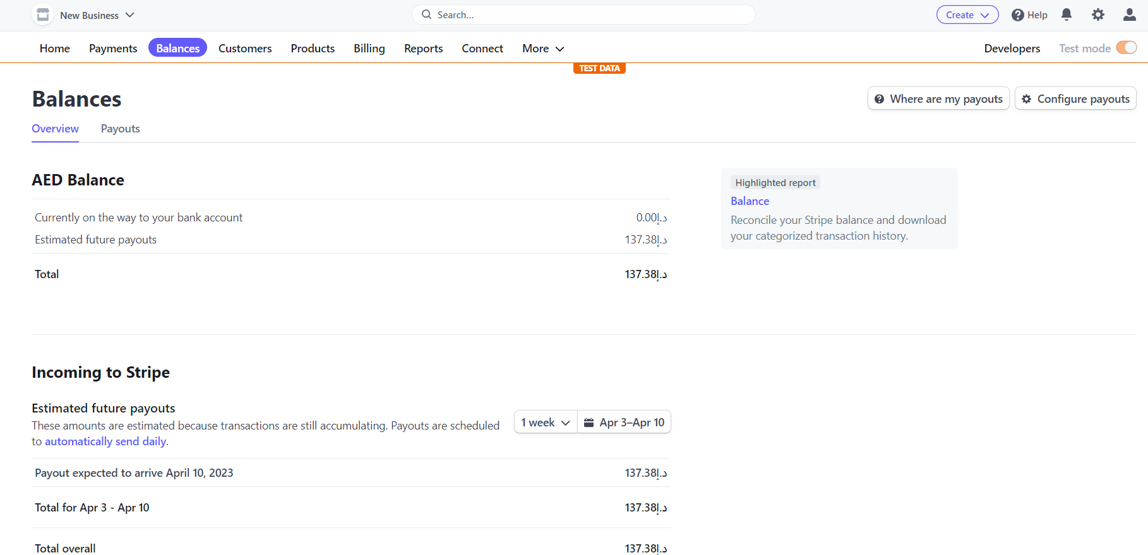
Check your balance and payouts

Slide 14
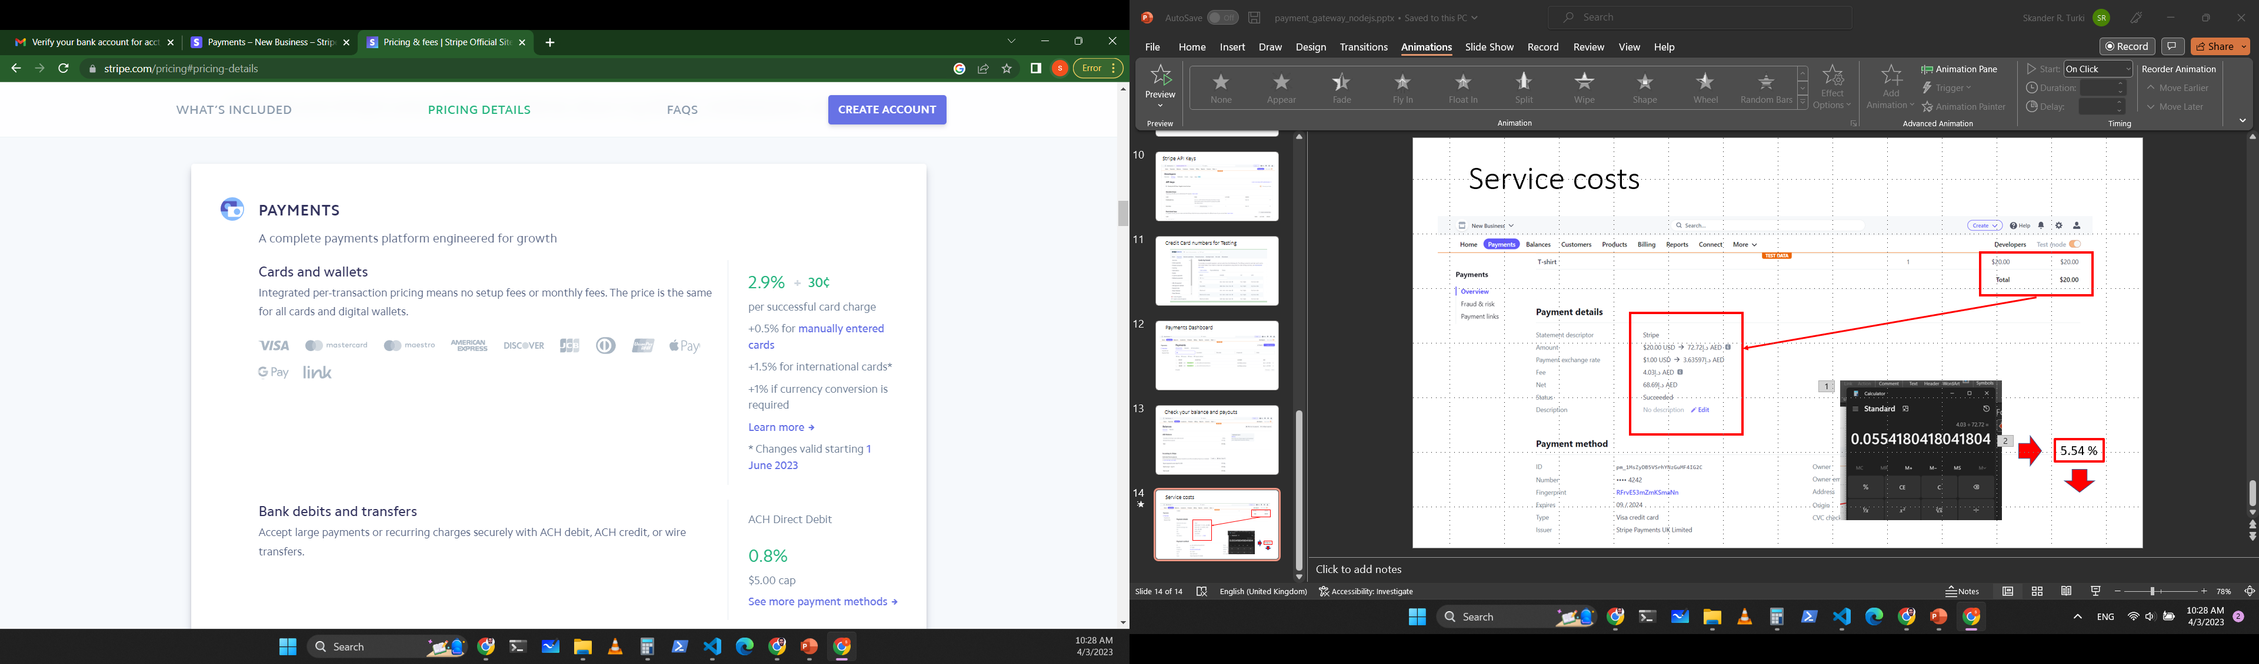
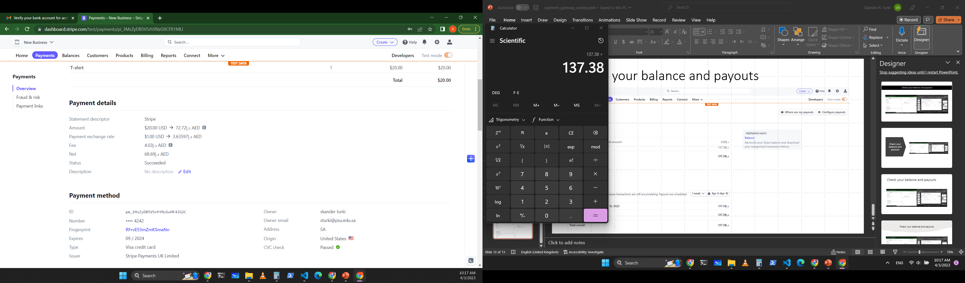
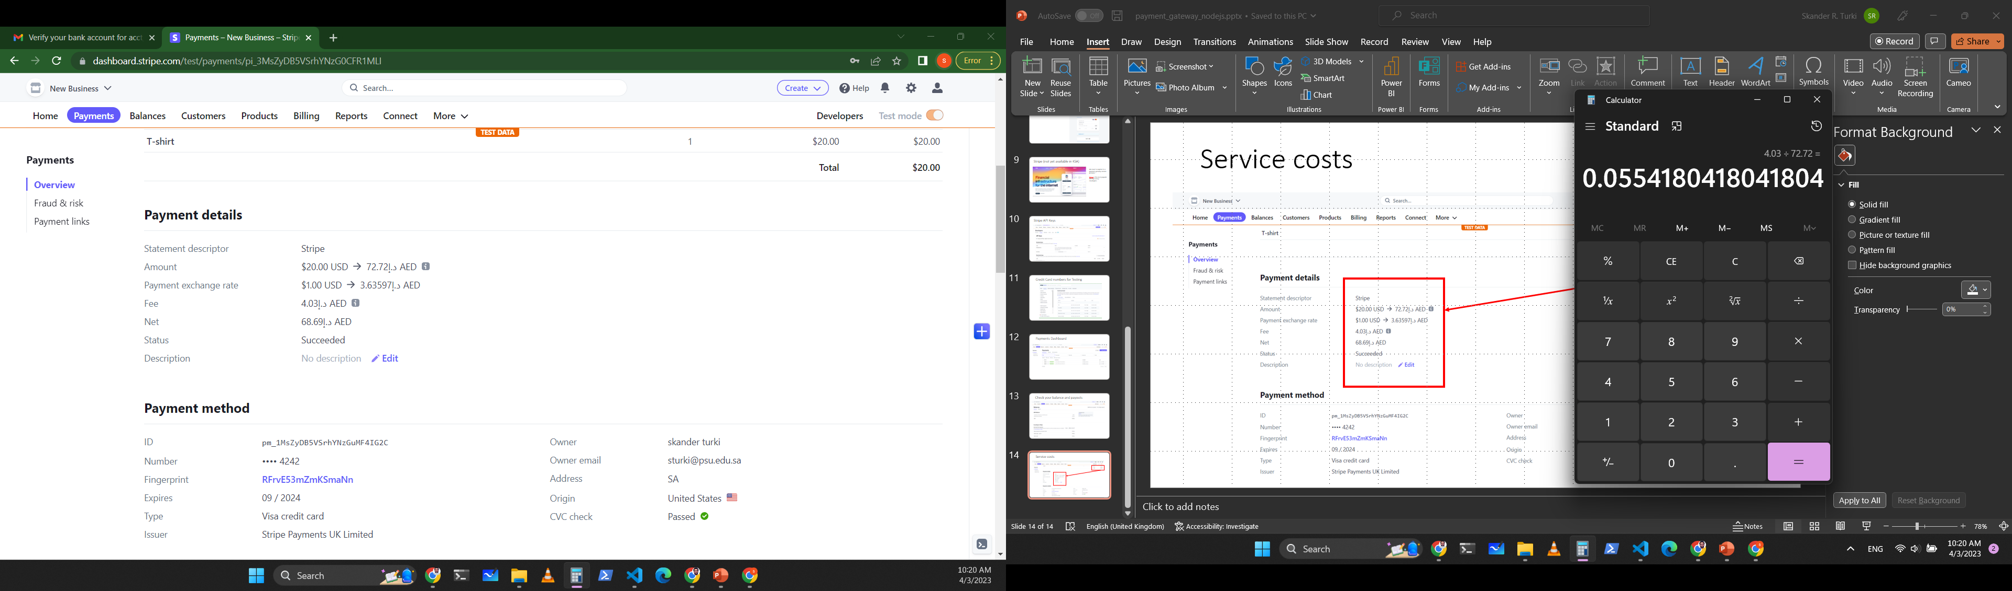

Service costs
5.54 %

Slide 15
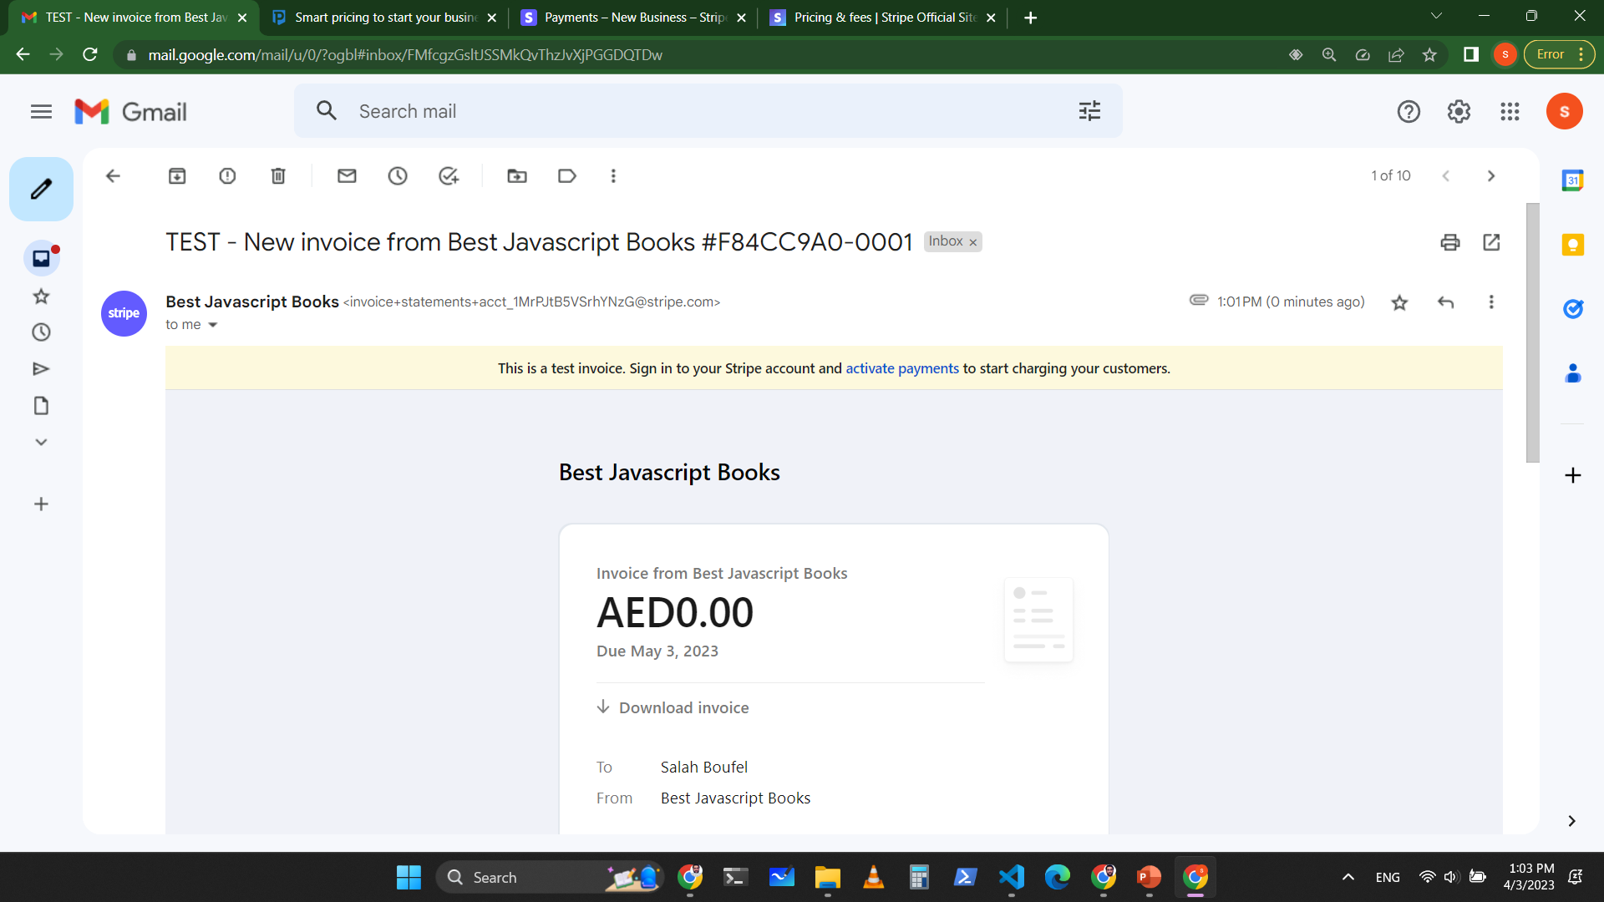
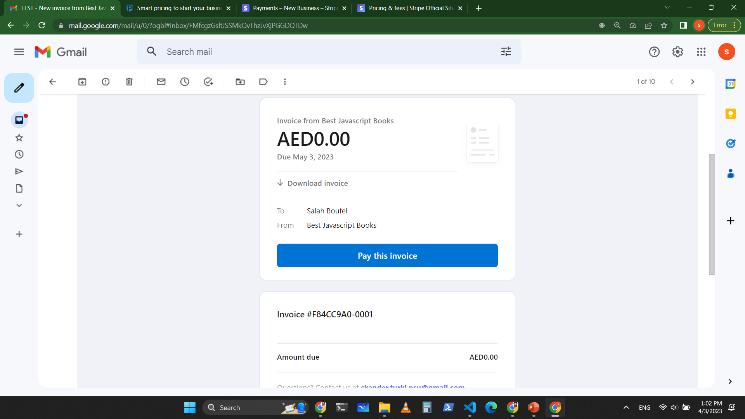
Send Invoices

Slide 16
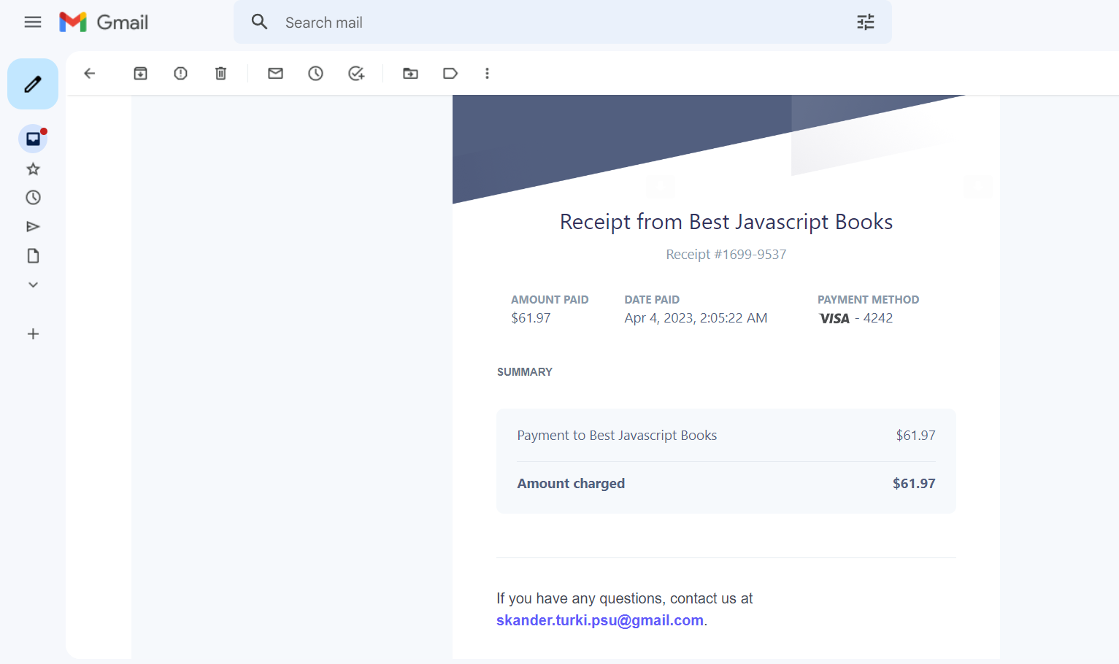
Send a receipt after payment

Slide 17
Security Concern !!
Users (customers) should not be able to modify the prices at the client side. Othewise a user can use javascript to modify item prices and set them to 0.

